Slide 1
PYTHON OPERATORS

Slide 2
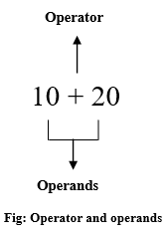
PYTHON OPERATORS
Operators are special symbols that perform specific operations on one or more operands (values) and then return a result.
For example, you can calculate the sum of two numbers using
an addition (+) operator.
Python has seven types of operators that we can use to perform different operation and produce a result.
Arithmetic operator
Relational operators
Assignment operators
Logical operators
Membership operators
Identity operators
Bitwise operators

Slide 3
ARITHEMATIC OPERATORS
Arithmetic operators are the most commonly used.
The Python programming language provides arithmetic operators that perform addition, subtraction, multiplication, and division. It works the same as basic mathematics.
There are seven arithmetic operators we can use to perform different mathematical operations, such as:
+ (Addition)
- (Subtraction)
* (Multiplication)
/ (Division)
// Floor division)
℅ (Modulus)
** (Exponentiation)

Slide 4
RELATIONAL OPERATORS
Operator | Description | Example
> (Greater than) | It returns True if the left operand is greater than the right | x > y result is True
< (Less than) | It returns True if the left operand is less than the right | x < y result is False
== (Equal to) | It returns True if both operands are equal | x == y result is False
!= (Not equal to) | It returns True if both operands are equal | x != y result is True
>= (Greater than or equal to) | It returns True if the left operand is greater than or equal to the right | x >= y result is True
<= (Less than or equal to) | It returns True if the left operand is less than or equal to the right | x <= y result is False
Relational operators are also called comparison operators. It performs a comparison between two values. It returns a boolean True or False depending upon the result of the comparison.
Python has the following six relational operators.
Assume variable x holds 10 and variable y holds 5

Slide 5
ASSIGNMENT OPERATORS
Operator | Meaning | Equivalent
= (Assign) | a=5 Assign 5 to variable a | a = 5
+= (Add and assign) | a+=5 Add 5 to a and assign it as a new value to a | a = a+5
-= (Subtract and assign) | a-=5 Subtract 5 from variable a and assign it as a new value to a | a = a-5
*= (Multiply and assign) | a*=5 Multiply variable a by 5 and assign it as a new value to a | a = a*5
/= (Divide and assign) | a/=5 Divide variable a by 5 and assign a new value to a | a = a/5
%= (Modulus and assign) | a%=5 Performs modulus on two values and assigns it as a new value to a | a = a%5
**= (Exponentiation and assign) | a**=5 Multiply a five times and assigns the result to a | a = a**5
//= (Floor-divide and assign) | a//=5 Floor-divide a by 5 and assigns the result to a | a = a//5
In Python, Assignment operators are used to assigning value to the variable. Assign operator is denoted by = symbol.
For example, name = "Jessa" here, we have assigned the string literal ‘Jessa’ to a variable name.
Also, there are shorthand assignment operators in Python. For example, a+=2 which is equivalent to a = a+2.

Slide 6
LOGICAL OPERATORS
Operator | Description | Example
and (Logical and) | True if both the operands are True | a and b
or (Logical or) | True if either of the operands is True | a or b
not (Logical not) | True if the operand is False | not a
LOGICAL OPERATORS
Logical operators are useful when checking a condition is true or not. Python has three logical operators. All logical operator returns a boolean value True or False depending on the condition in which it is used.
and (Logical and)
The logical and operator returns True if both expressions are True. Otherwise, it will return. False.
or (Logical or)
The logical or the operator returns a boolean True if one expression is true, and it returns False if both values are false.
not (Logical not)
The logical not operator returns boolean True if the expression is false.

Slide 7

MEMBERSHIP OPERATORS
Python’s membership operators are used to check for membership of objects in sequence, such as string, list, tuple. It checks whether the given value or variable is present in a given sequence. If present, it will return True else False.
In Python, there are two membership operator in and not in
In operator
It returns a result as True if it finds a given object in the sequence. Otherwise, it returns False.
Not in operator
It returns True if the object is not present in a given sequence. Otherwise, it returns False

Slide 8
IDENTITY OPERATORS
Use the Identity operator to check whether the value of two variables is the same or not. This operator is known as a reference-quality operator because the identity operator compares values according to two variables’ memory addresses.
Python has 2 identity operators is and is not.
IS operator
The is operator returns Boolean True or False. It Return True if the memory address first value is equal to the second value. Otherwise, it returns False.
IS NOT operator
The is not the operator returns boolean values either True or False. It Return True if the first value is not equal to the second value. Otherwise, it returns False.

Slide 9
BITWISE OPERATORS
& Bitwise and
In Python, bitwise operators are used to performing bitwise operations on integers. To perform bitwise, we first need to convert integer value to binary (0 and 1) value.
The bitwise operator operates on values bit by bit, so it’s called bitwise. It always returns the result in decimal format. Python has 6 bitwise operators listed below.
| Bitwise or
^ Bitwise xor
~ Bitwise 1’s complement
<< Bitwise left-shift
>> Bitwise right-shift

Slide 10
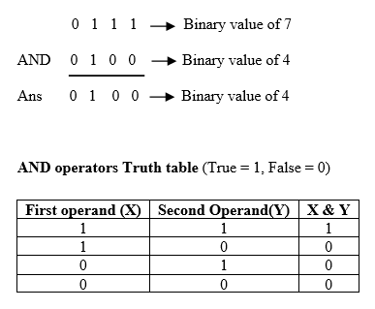
CONTD.,
Bitwise and &
It performs logical AND operation on the integer value after converting an integer to a binary value and gives the result as a decimal value. It returns True only if both operands are True. Otherwise, it returns False.
Here, every integer value is converted into a binary value.
For example, a =7, its binary value is 0111,
and b=4, its binary value is 0100.
Next we performed logical AND, and got 0100 as a result,
Following diagram shows AND operator evaluation.

Slide 11
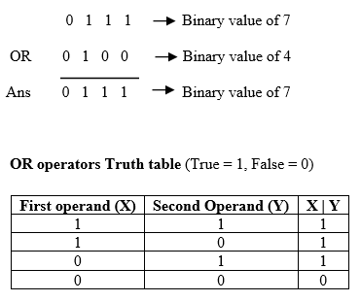
CONTD.,
Bitwise or |
It performs logical OR operation on the integer value after converting integer value to binary value and gives the result a decimal value. It returns False only if both operands are True. Otherwise, it returns True.
Here, every integer value is converted into a binary value.
For example, a =7, its binary value is 0111,
and b=4, its binary value is 0100.
Next we performed logical OR, and got 0111 as a result,
Following diagram shows OR operator evaluation.

Slide 12
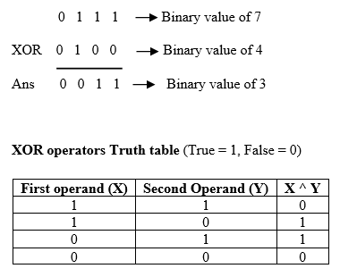
CONTD.,
Bitwise xor ^
It performs Logical XOR ^ operation on the binary value of a integer and gives the result as a decimal value.
Here, every integer value is converted into a binary value.
For example, a =7, its binary value is 0111,
and b=4, its binary value is 0100.
Next we performed logical OR, and got 0111 as a result,
Following diagram shows OR operator evaluation.
Bitwise 1’s complement ~
It performs 1’s complement operation. It invert each bit of binary value and returns the bitwise negation of a value as a result.

Slide 13
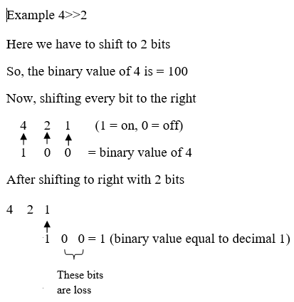
CONTD.,
Bitwise Right-shift >>
The left-shift >> operator performs shifting a bit of value to the right by a given number of places. Here some bits are lost.

Slide 14
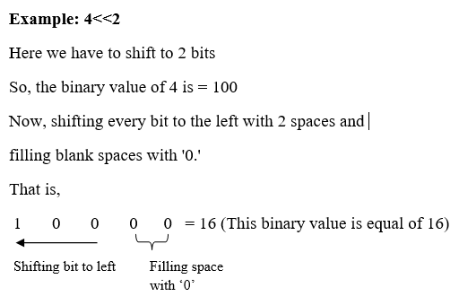
CONTD.,
Bitwise left-shift <<
The left-shift << operator performs a shifting bit of value by a given number of the place and fills 0’s to new positions.

Slide 15
OPERATOR PRECEDENCE
Precedence level | Operator | Meaning
1 (Highest) | () | Parenthesis
2 | ** | Exponent
3 | +x, -x ,~x | Unary plus, Unary Minus, Bitwise negation
4 | *, /, //, % | Multiplication, Division, Floor division, Modulus
5 | +, - | Addition, Subtraction
6 | <<, >> | Bitwise shift operator
7 | & | Bitwise AND
8 | ^ | Bitwise XOR
9 | | | Bitwise OR
10 | ==, !=, >, >=, <, <= | Comparison
11 | is, is not, in, not in | Identity, Membership
12 | not | Logical NOT
13 | and | Logical AND
14 (Lowest) | or | Logical OR
In Python, operator precedence and associativity play an essential role in solving the expression. An expression is the combination of variables and operators that evaluate based on operator precedence.
We must know what the precedence (priority) of that operator is and how they will evaluate down to a single value. Operator precedence is used in an expression to determine which operation to perform first.
The following tables shows operator precedence highest to lowest.

